Slide 1
BITS Pilani
Prof.Aruna Malapati
Department of CSIS

Slide 2
Maximum Entropy Markov Model for POS Tagging

Slide 3
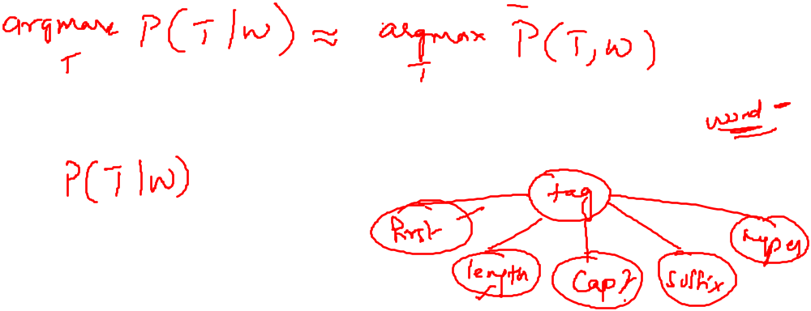
Discriminative Models

Slide 4
Maximum Entropy Model (MEM)
MEM/MaxEnt is another name for multinomial logistic regression that belong to the family of classifiers known as the exponential or log-linear classifiers.
  Extract some set of features from the input.
  Combine them linearly(i.e multiply the weight and ass them up)
  Use this sum as an exponent
Given the features and weights, out goal is to choose a class(For example a part of speech) for the word.
Notes:
MaxEnt is a discriminative classifier, especially useful when can’t estimate full probabilities properly.

Slide 5
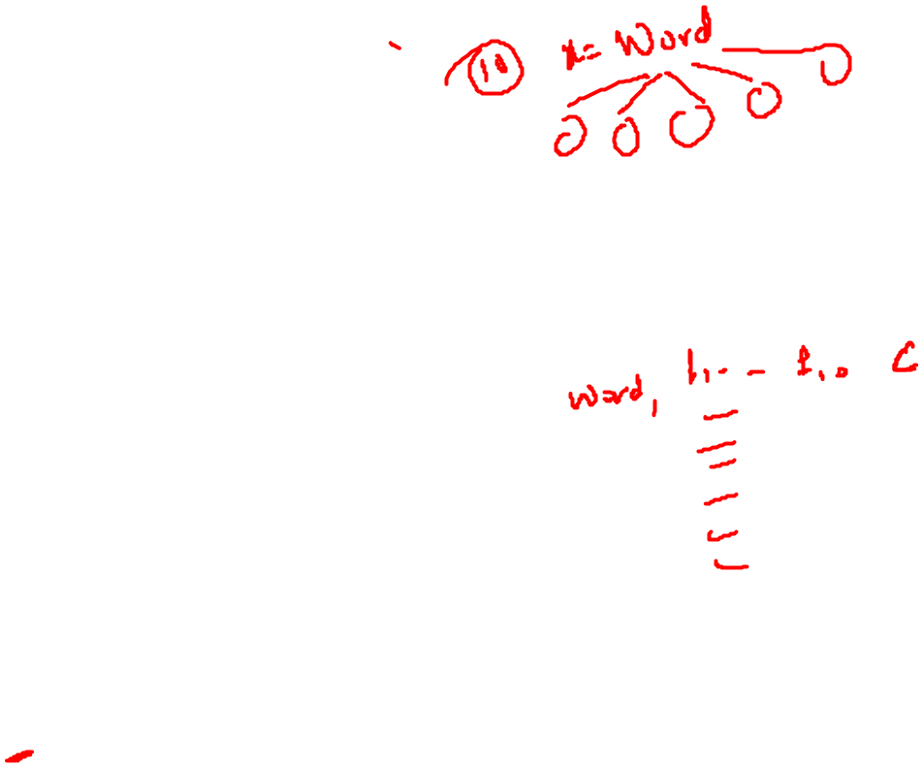
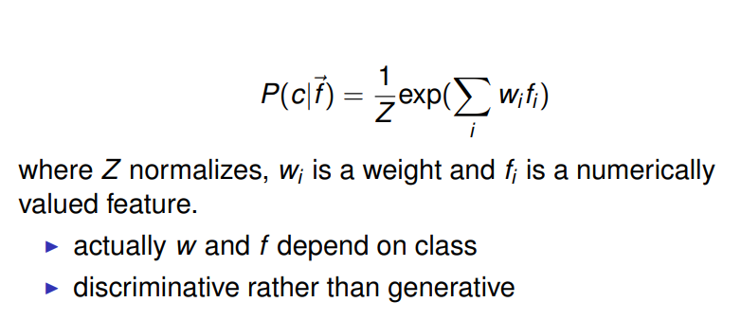
Maximum Entropy Model (MEM)
MaxEnt does this by choosing the most probable tag: the probability of a particular class (tag) c given the observation x described using a set of features f.

Slide 6
Discriminative classifiers
In order to understand MaxEnt we need a few basics of
Linear Regression
Logistic Regression
MaxEnt(Multinomial Regression)
MaxEnt for sequence classification

Slide 7
Discriminative Models

Slide 8
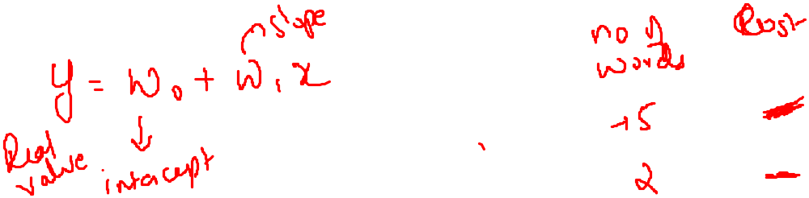
Linear Regression

Slide 9
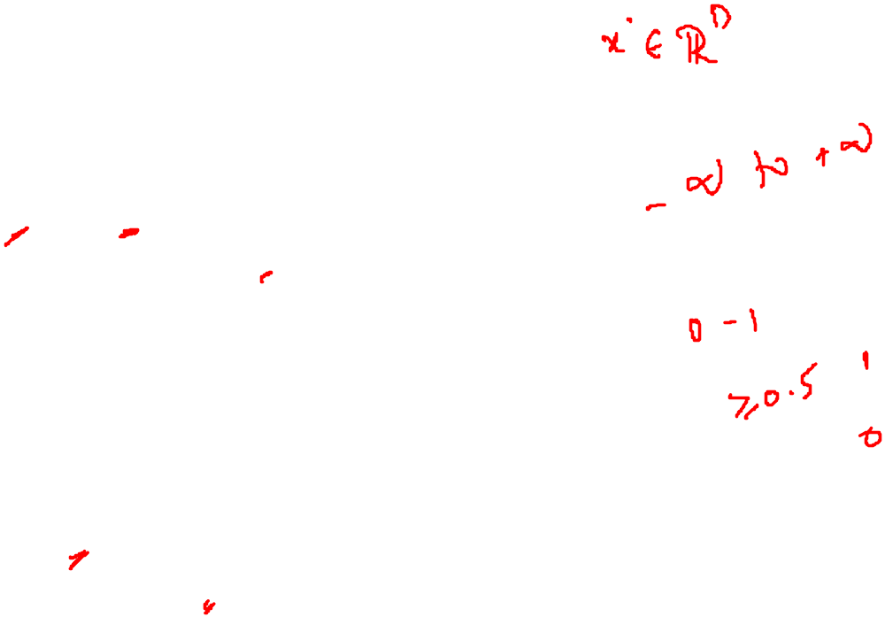
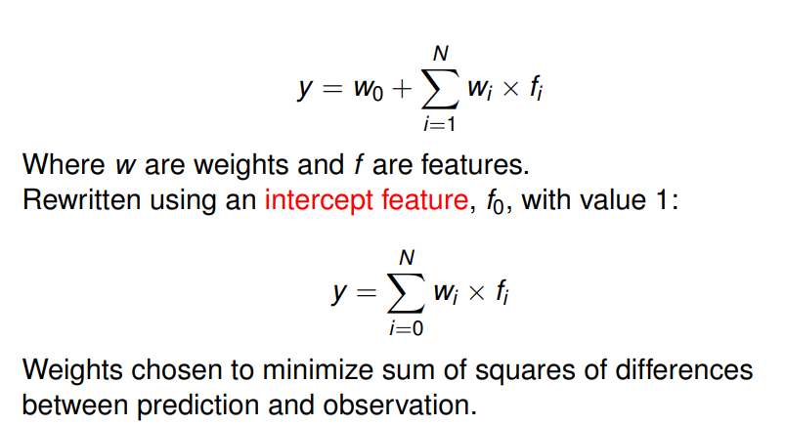
Multiple Linear regression

Slide 10
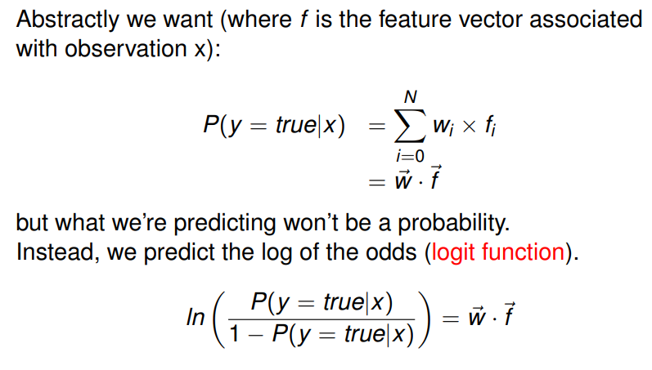
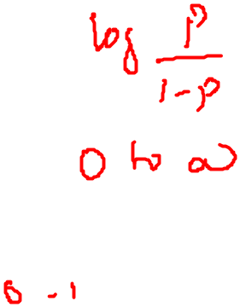
Multiple Linear Regression

Slide 11
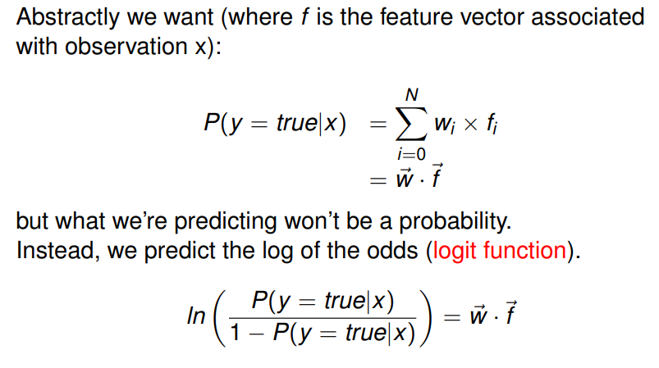
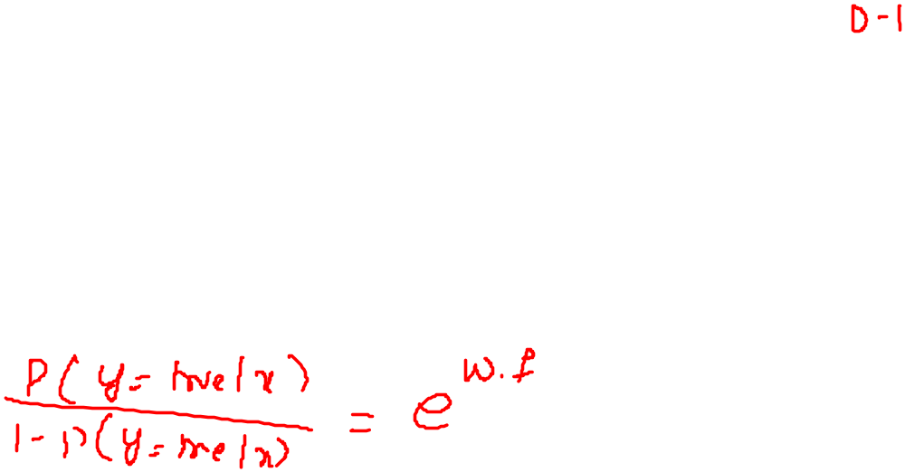
Logistic Regression

Slide 12
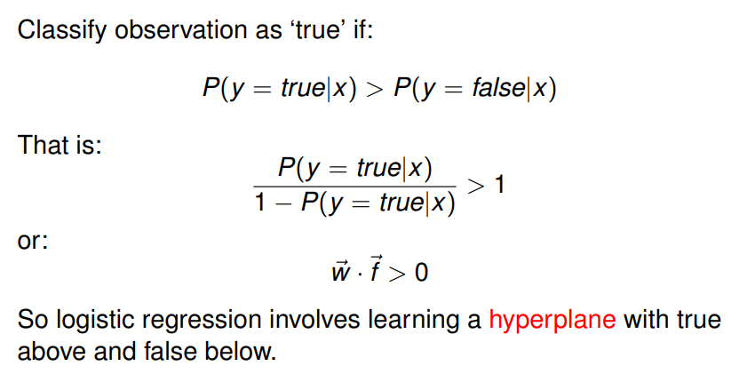
Logistic regression (contd…)

Slide 13
Logistic regression (contd…)

Slide 14
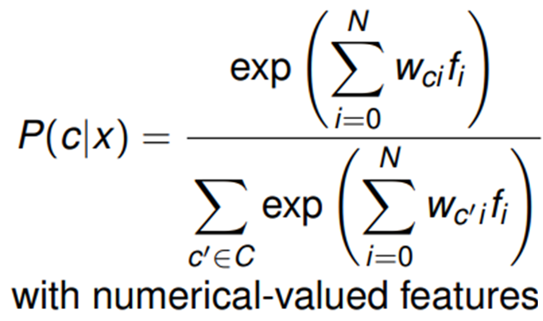
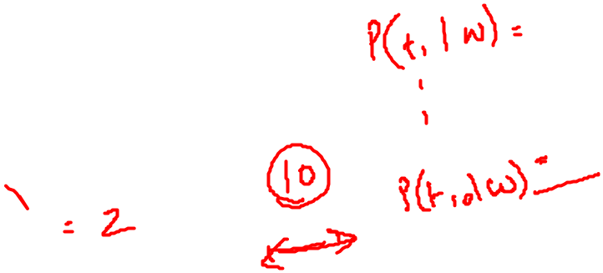
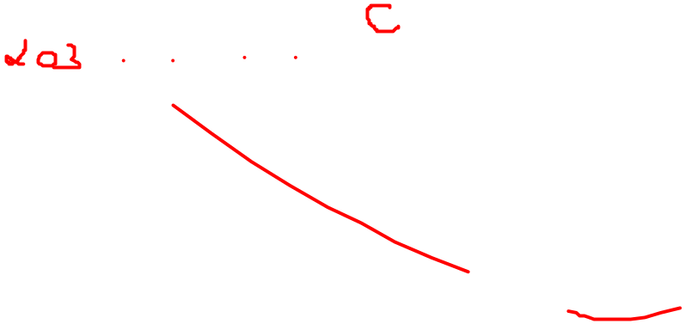
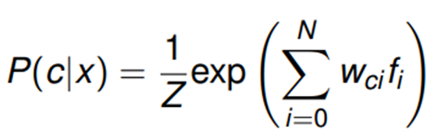
MaxEnt: Multinomial logistic regression
Logistic regression with more than two classes is Multinomial logistic regression.
Also known as Maximum Entropy(MaxEnt) classifier
The denominator is the normalization factor used to make the score into a proper probability distribution

Slide 15
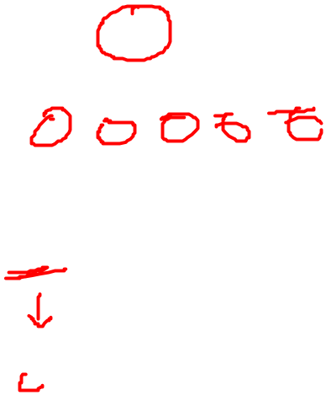
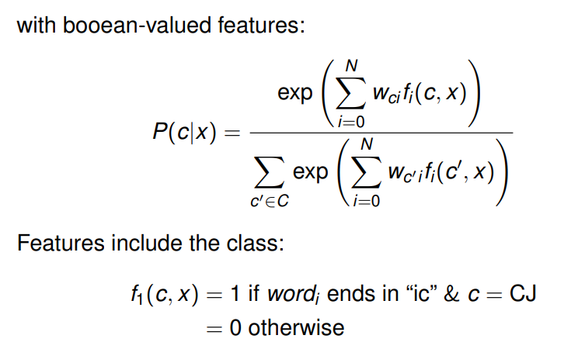
MaxEnt: Multinomial logistic regression

Slide 16
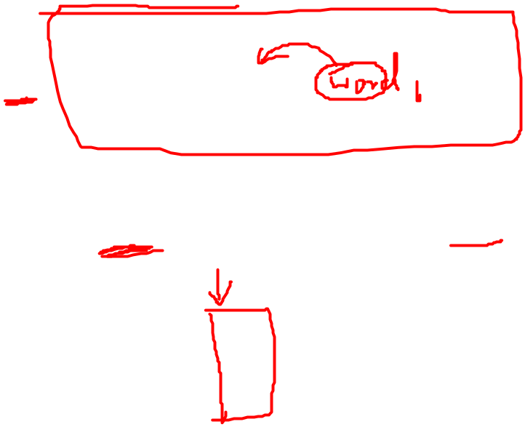
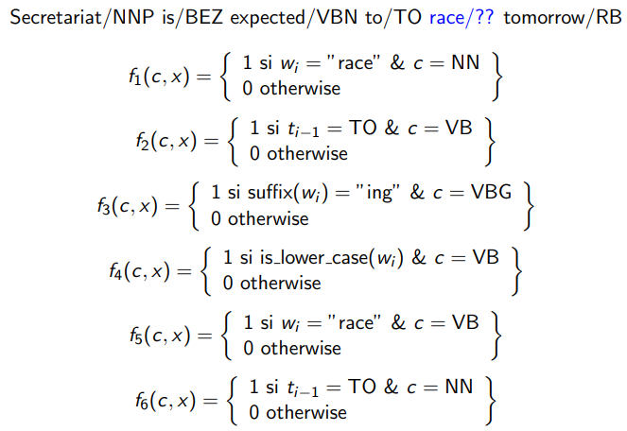
Example of non-sequential classification

Slide 17

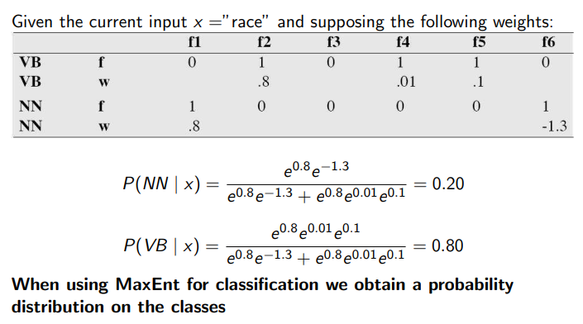
Example of non-sequential classification

Slide 18
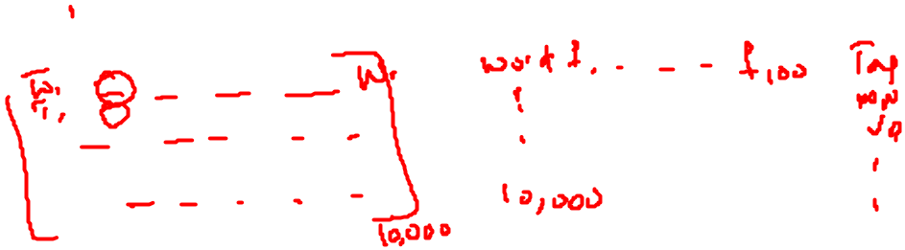
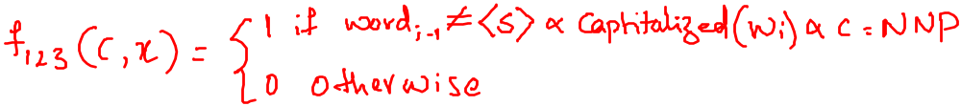
Complex Features
Consider proper nouns: a word is likely to be a proper noun if it starts with a capital letter and is not the first word of the sentence.
We need a conjunction of two primitive features
Note: We need to define such feature conjunctions explicitly as opposed to other ML (e.g. SVMs) that can handle this directly.

Slide 19
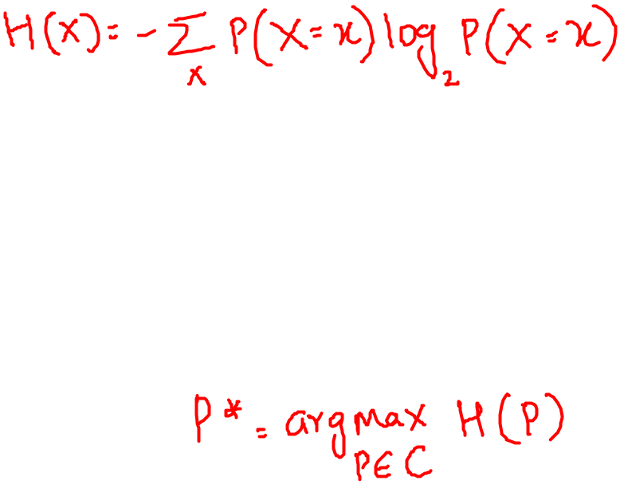
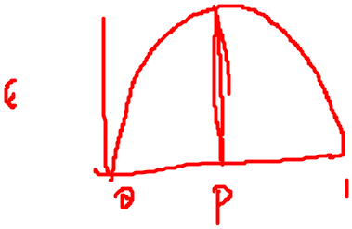
Why MaxEnt?
Out of all the possible models, choose the simplest one consistent with the data (Occam’s razor)
Entropy of the distribution of discrete random variable X:
The uniform distribution has the highest entropy.
Finding maximum entropy distribution in the set C of possible distributions

Slide 20
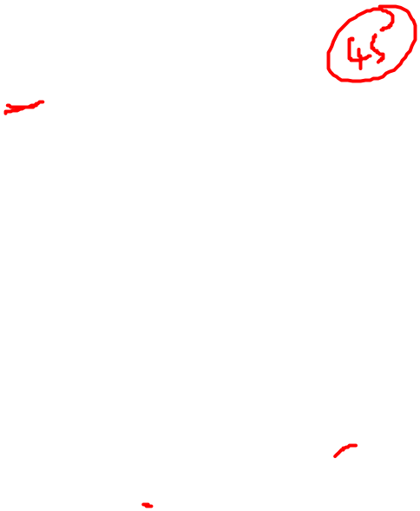
MaxEnt: example
We want to assign a tag to the word zzfish
Initial model
The set of possible tags for zzfish are NN,JJ,NNS and VB(based on some training data)
NN | JJ | NNS | VB | NNP | IN | MD | UH | SYM | VBG | POS | PRP | CC | CD | …
10 45 | 10 45 | 10 45 | 10 45 | 10 45 | 10 45 | 10 45 | 10 45 | 10 45 | 10 45 | 10 45 | 10 45 | 10 45 | 10 45 | 10 45
NN | JJ | NNS | VB | NNP | IN | MD | UH | SYM | VBG | POS | PRP | CC | CD | …
10 4 | 10 4 | 10 4 | 10 4 | 0 | 0 | 0 | 0 | 0 | 0 | 0 | 0 | 0 | 0 | 0

Slide 21
MaxEnt: example
8 times out of 10, zzfish was tagged as some sort of common noun either NN or NNS
In the training data for all English words (not just zzfish) verbs (VB) occur as 1 word in 20.
NN | JJ | NNS | VB | NNP | ….
4/10 | 1/10 | 4/10 | 1/10 | 0 | ….
P(NN)+P(JJ)+P(NNS)+P(VB)=1
P(word is zzfish and t1=NN or t1=NNS) = 8/10
NN | JJ | NNS | VB
4/10 | 1/20 | 4/10 | 1/20
P(NN)+P(JJ)+P(NNS)+P(VB)=1
P(word is zzfish and t1=NN or t1=NNS) = 8/10
P(VB)=1/20

Slide 22
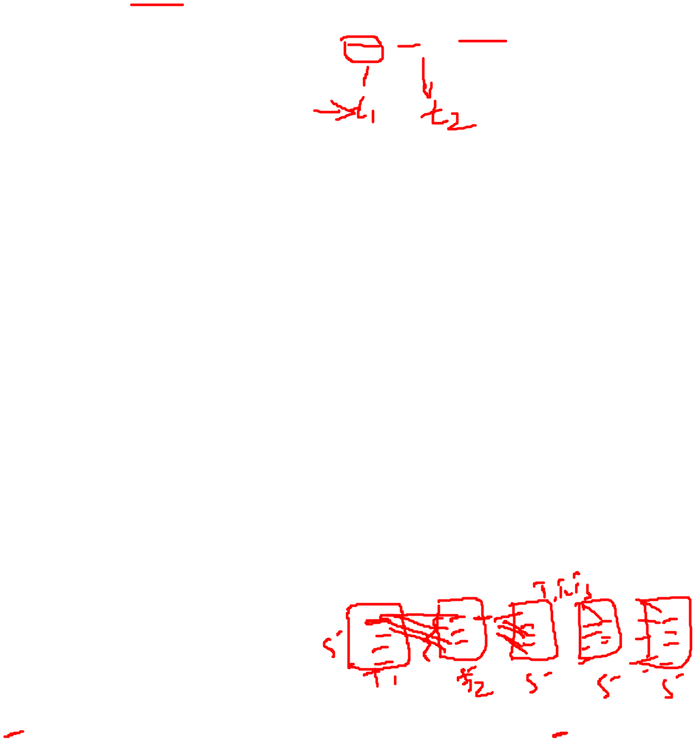
Maximum Entropy Markov Model
First Solution: run a local classifier left to right, first making a hard classification of the first word in the sentence, then the second word, and so on.
Use the output of the classifier from the previous word as a feature to predict the tag of the current word.
The problem with hard classification on each word before moving on to the next word is that global optimal sequence cannot be achieved.
Hence we combine Viterbi algorithm with MaxEnt:Maximum Entropy Markov Model (MEMM)

Slide 23
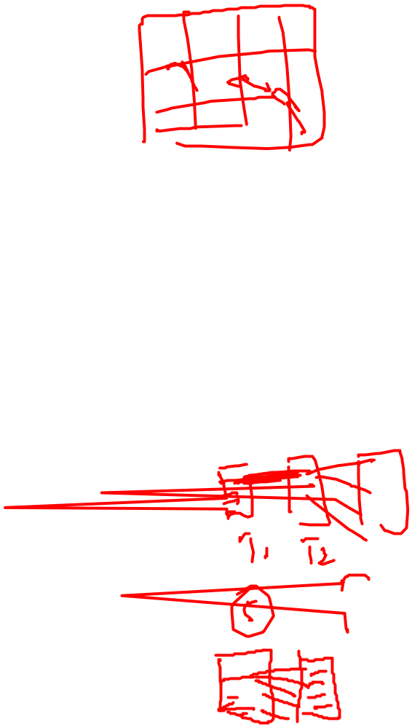
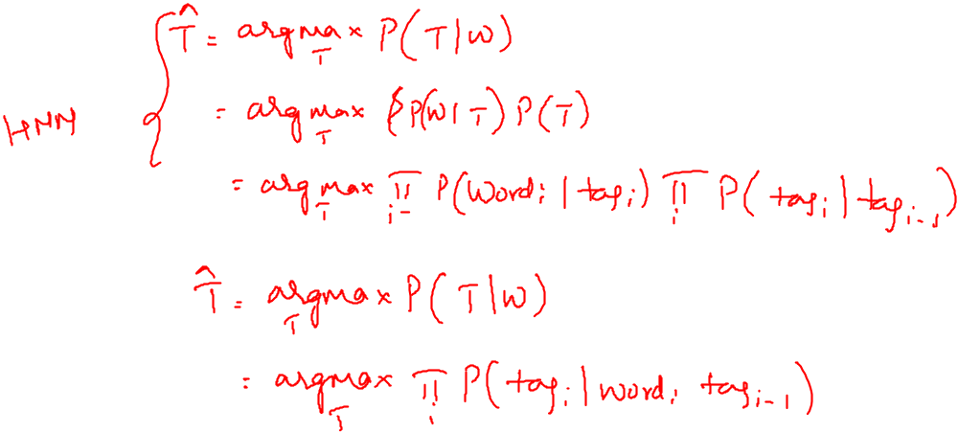
HMMs VS MEMM

Slide 24
Summary
• MaxEnt is a multinomial logistic regression.

